Slide 1


06 - Ecological Niche Modeling
Shelly Gaynor
University of Florida

Slide 2
R based Ecological Niche Models
dismo and ENMeval

Slide 3
ENMeval Improvements
Additional methods for partitioning occurrence and background data into subsets for training and validation.
Builds models with different algorithmic settings and evaluates each model.

Slide 4
Data Partitioning
partition occurrence localities into testing and training bins (folds) for k-fold cross-validation
Previous options:
Bootstrap
Subsample
Crossvalidate
Muscarella et al. 2014

Slide 5
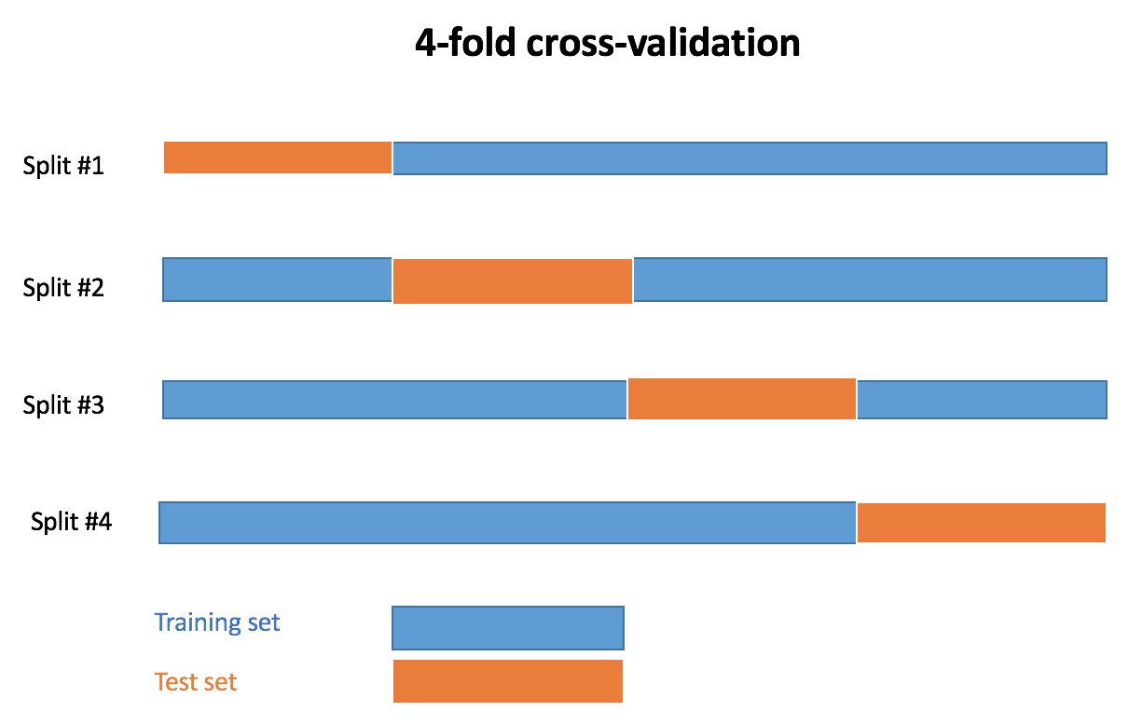
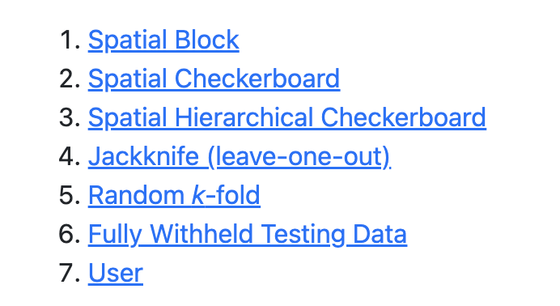
Cross Validation
Cross validation = resampling to evaluate model’s performance with limited data
ENMeval
Slide modified from M. Mabry

Slide 6
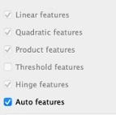
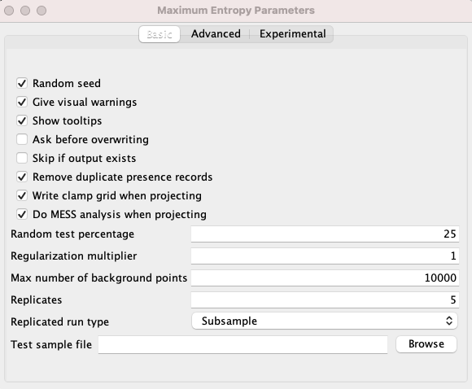
Different algorithmic settings
ENMeval allow the comparison of models with multiple regularization multipliers and different feature classes included
Feature class is used to transform the original predictor
Determines the shape of the marginal responses curve
MaxEnt Feature Classes:
linear (L)
quadratic (Q)
product (P)
threshold (T)
hinge (H)
Determines the penalty associated with including variables or their transformations in the model.
Notes:
Feature class is the method used to transform the original predictor value
feature classes determine the potential shape of the marginal response curves.
regularization multiplier (RM) determines the penalty associated with including variables or their transformations in the model.

Slide 7
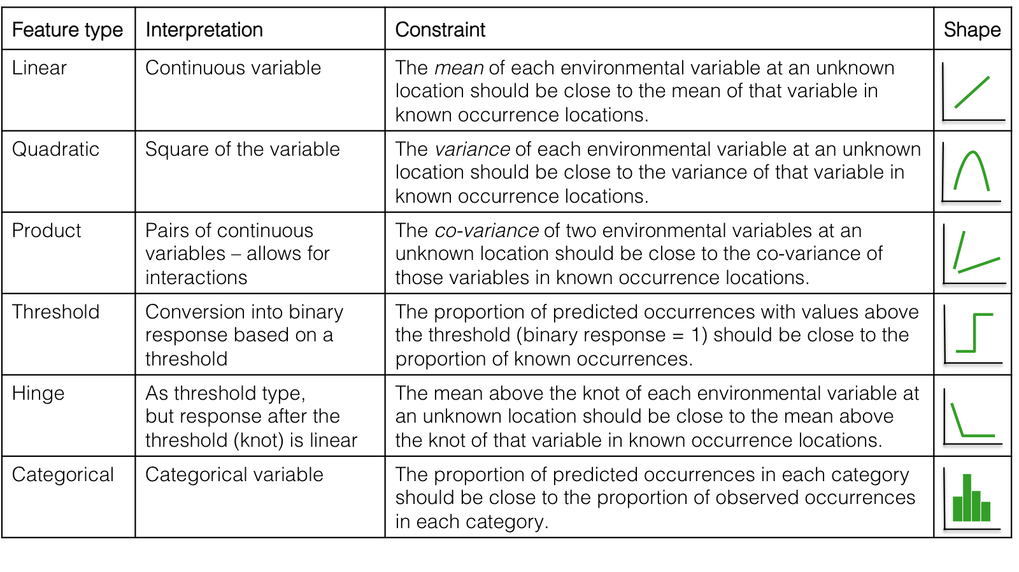
Feature Class (fc)
Slide modified from M. Mabry
Notes:
Land use = good for

Slide 8
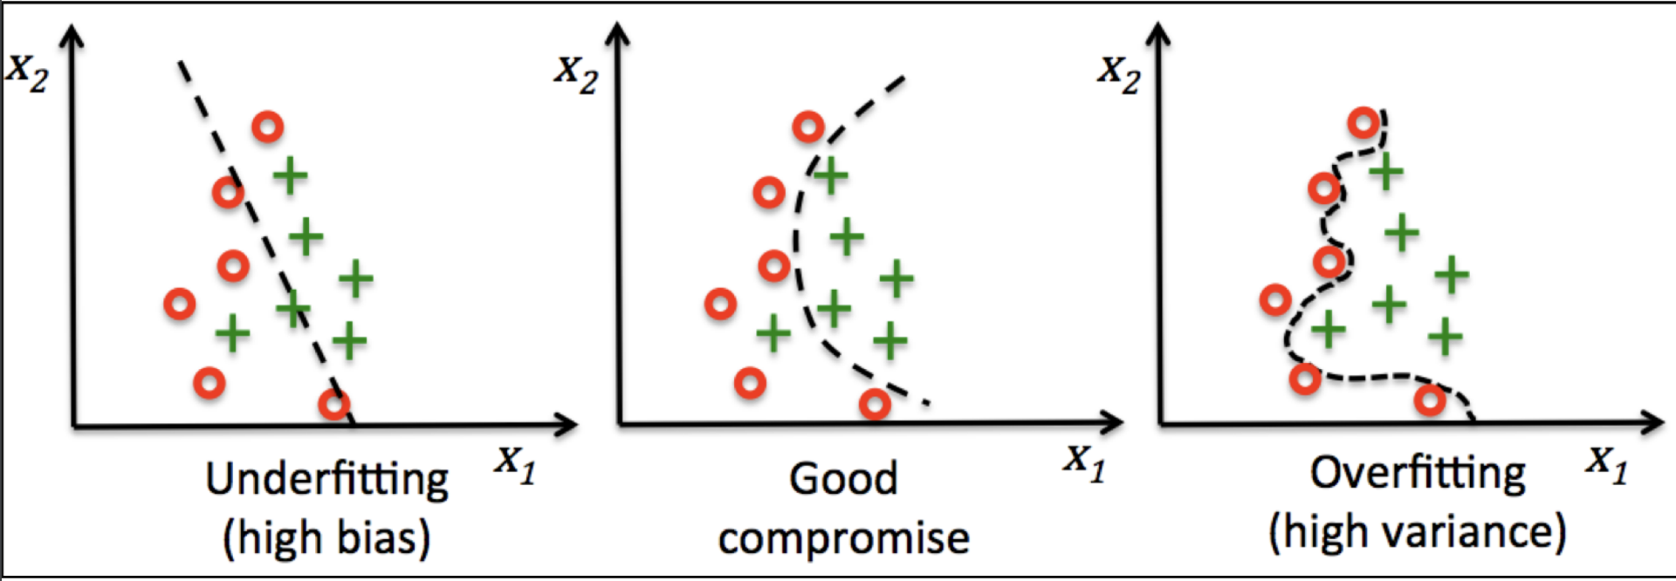
Regularization Multiplier (rm)
Regularization multiplier (rm) then aims to reduce overfitting of the model:
Determines the penalty associated with including variables or their transformations in the model.
rm is too high
rm = 0
Notes:
Feature class is the method used to transform the original predictor value
feature classes determine the potential shape of the marginal response curves.
regularization multiplier (RM) determines the penalty associated with including variables or their transformations in the model.
If set to 0, all feature classes and variables are included: this could lead to overfitting
If set too high, the model could be underfit

Slide 9
Background Points (n.bg)
Defines the available env. by sampling a large number of points across the study area.
Used to define relative env. suitability.

Slide 10
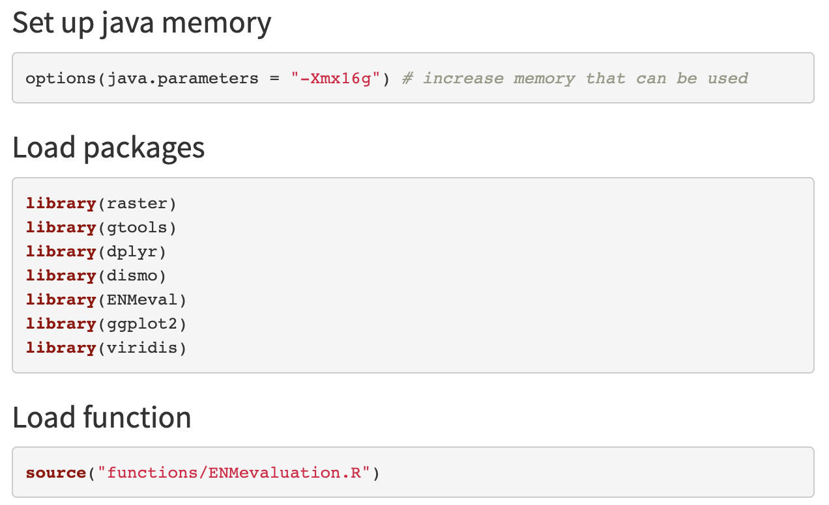
Load Packages, Functions, & Java

Slide 11
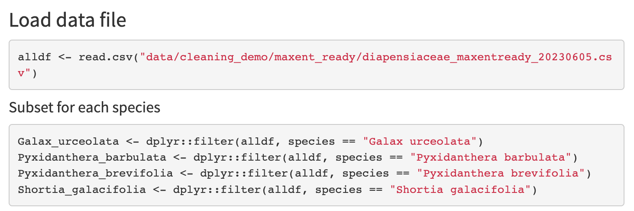
Load Data Files

Slide 12
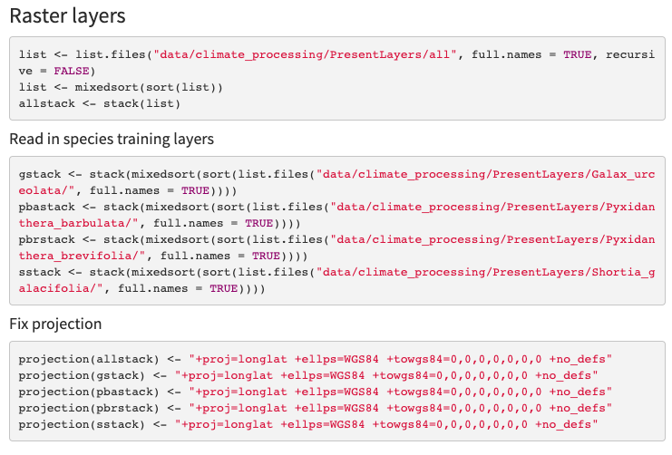
Load Raster Layers

Slide 13
Load Raster Layers

Slide 14
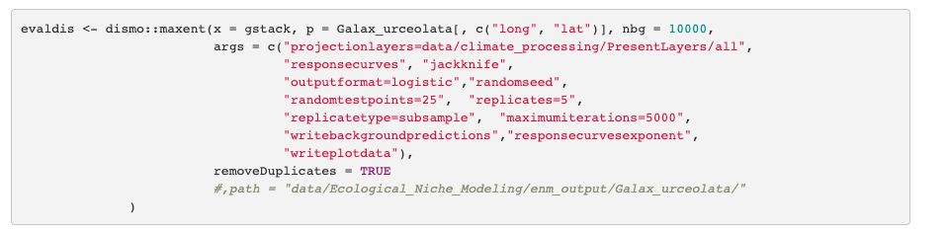
WARNING: TIME INTENSIVE
dismo Model

Slide 15
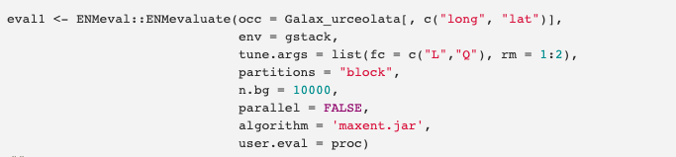
ENMeval Model
For publication worthy comparisons – test more feature-class combinations and a larger range of regularization multipliers:
Ex.: fc = c(“L”, “H”, “LQ”, “LHQ”, “LQP”), rm = c(0.5, 1.0, 1.5, 2.0, 2.5, 3.0, 3.5, 4.0)
For example, see: Wang et al. 2021. Potential distributional shifts in North America of allelopathic invasive plant species under climate change models. Plant Diversity.

Slide 16
Continued in
Interpreting ENMs

